Slide 1

01
Drug Persistence and medical adherence
An EDA presentation by Feature Transformers

Slide 2
15
NAME
Wangu Ndungu
EMAIL ADDRESS
Group Name:
nwangu349@gmail.com
COUNTRY
Kenya
Feature Transformers
COLLEGE
Kenyatta University
SPECIALIZATION
Data Science
Business plan | January 2020

Slide 3
Problem statement
Business understanding
Definition of terms
Adherence and Persistence analysis
Patients' analysis
Patients' Risk Analysis
Drug Comorbidity and Concomity
Conclusion and model recommendations
02
Presentation Highlights

Slide 4
Problem Statement
03
According to the World Health Organisation, only 50-70% of patients adhere properly to prescribed drugs during therapy. This is especially true among those with long-term medication. This
worrying statistic is caused by various factors, for example patients’ condition or disease, their
socio-economic status, confusion by the schedule, forgetting, or discontinuing because they feel better, just to name a few. Medical non-adherence can lead to devastating consequences on one’s health,
especially for those with chronic illnesses. The purpose of this project is to study trends among patients in a sample and build a model that’ll classify a new patient as Persistent or Non-Persistent. This project will give medical practitioners(especially pharmaceuticals) insight into which patients might require more rigorous follow-ups to ensure they will adhere to their prescriptions.

Slide 5
Business Understanding
04
According to a study carried out by LexisNexis in 2020, Medical Non-adherence is one of the biggest issues faced by the pharmacy industry. Pharmacists stated that they would want to put more effort into educating patients on the importance of medical adherence, send remainders to them, improve drug packaging and much more to deal with the issue.
Technology and Machine Learning being incorporated into the industry would help pharmacists identify patients who are likely to be non-adherent and non-persistent

Slide 6
Medical adherence
According to the FDA, it can be termed as : "The extent to which patients take medication as prescribed by their doctors. This involves factors such as getting prescriptions filled, remembering to take medication on time, and understanding the directions."
05
Drug Persistence
The extent to which a patient acts in compliance to the prescribed interval, and dose of a dosing regimen.
So what's the difference between these two terms? Adherence refers to the proportion of pills taken within a specific time interval and persistence refers to the continuing use (in time) of the prescribed therapy.
Definition of terms
Concomitant Drugs
Two or more drugs given at the same or almost the same time
Comorbidity
The presence of two or more diseases or medical conditions
IDN(Integrated Delivery Network)
Network of healthcare providers and facilities within a specific geographical location that offer a full range of healthcare services
T-score
Measure of standard deviation that shows how much your bone density differs from the bone mass of an average healthy adult

Slide 7
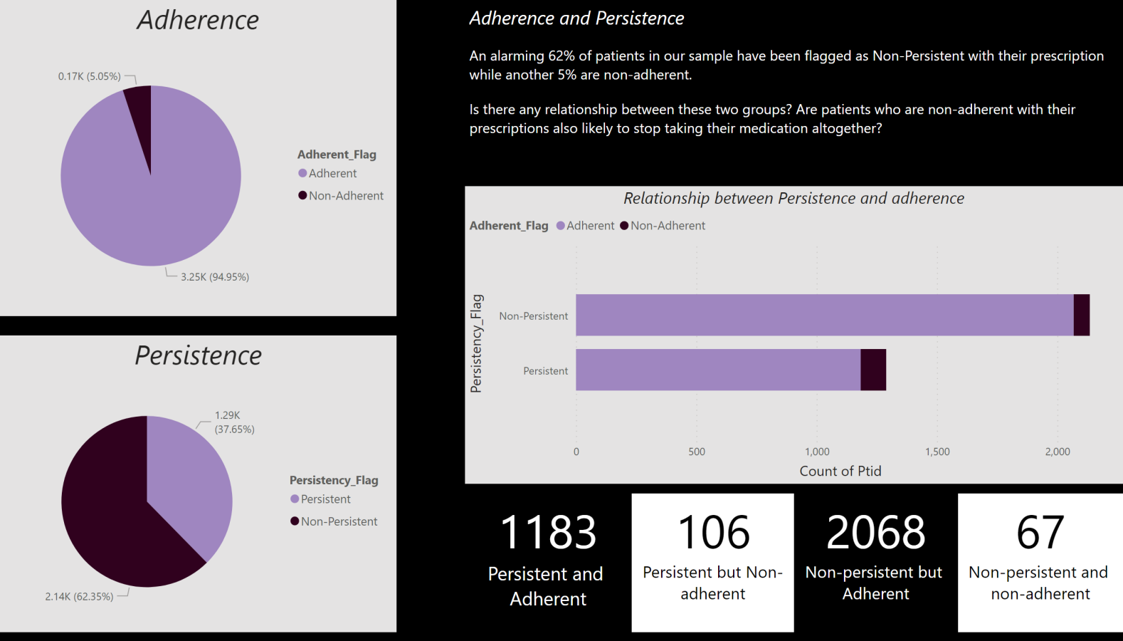

Slide 8
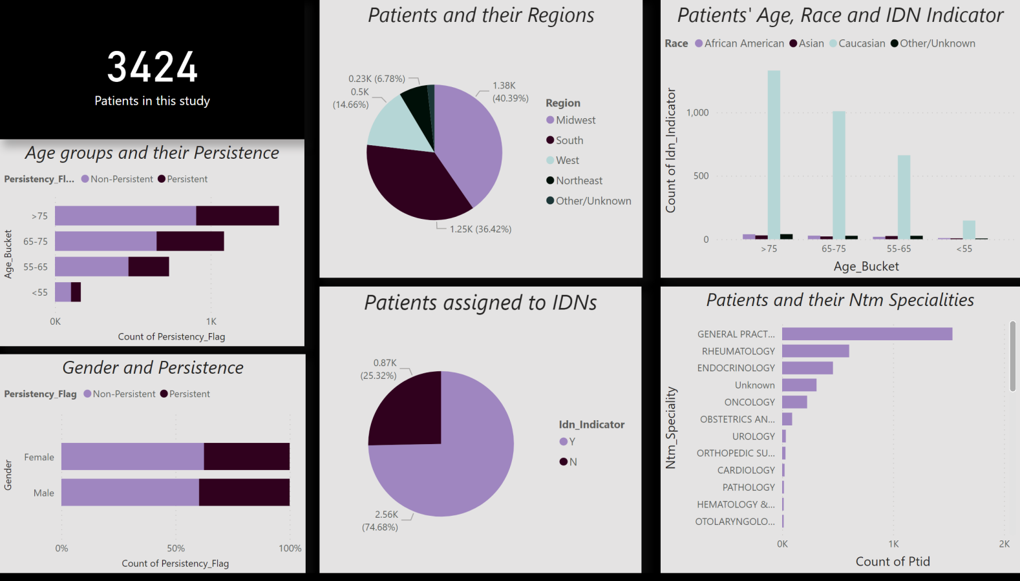

Slide 9
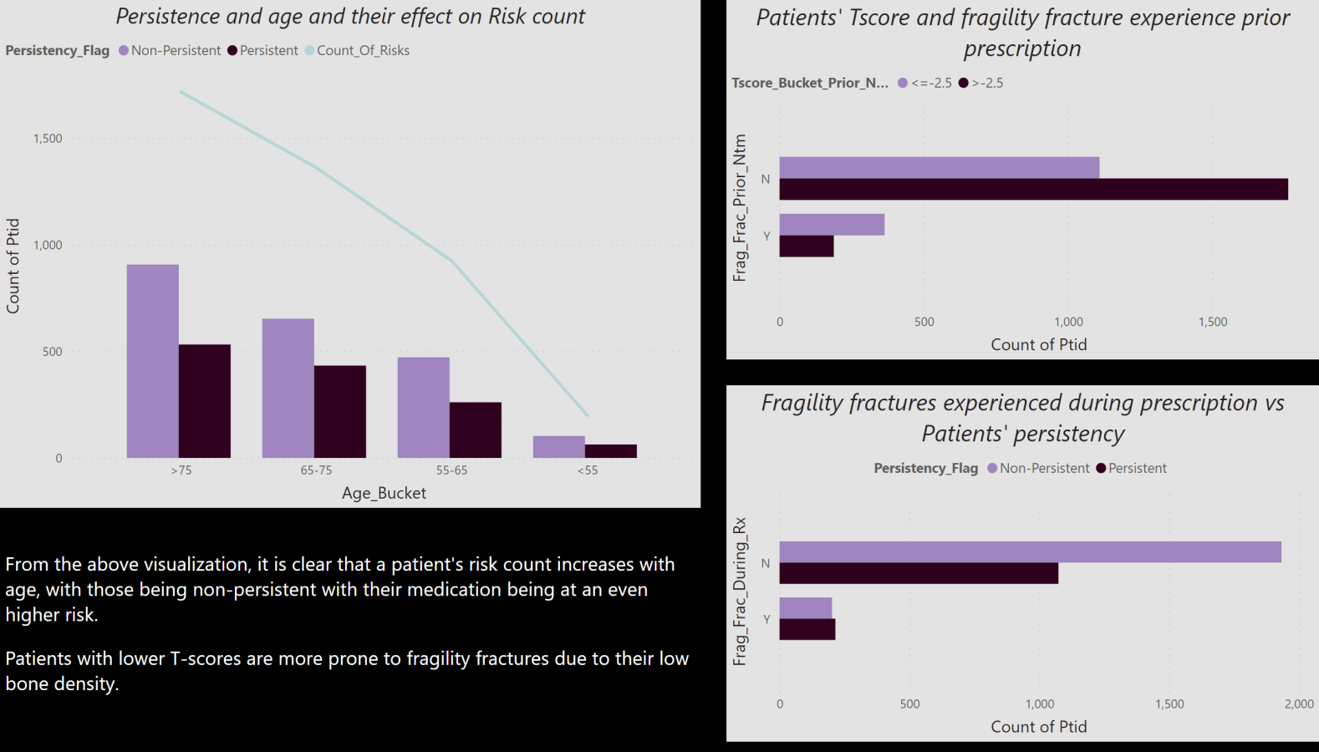

Slide 10
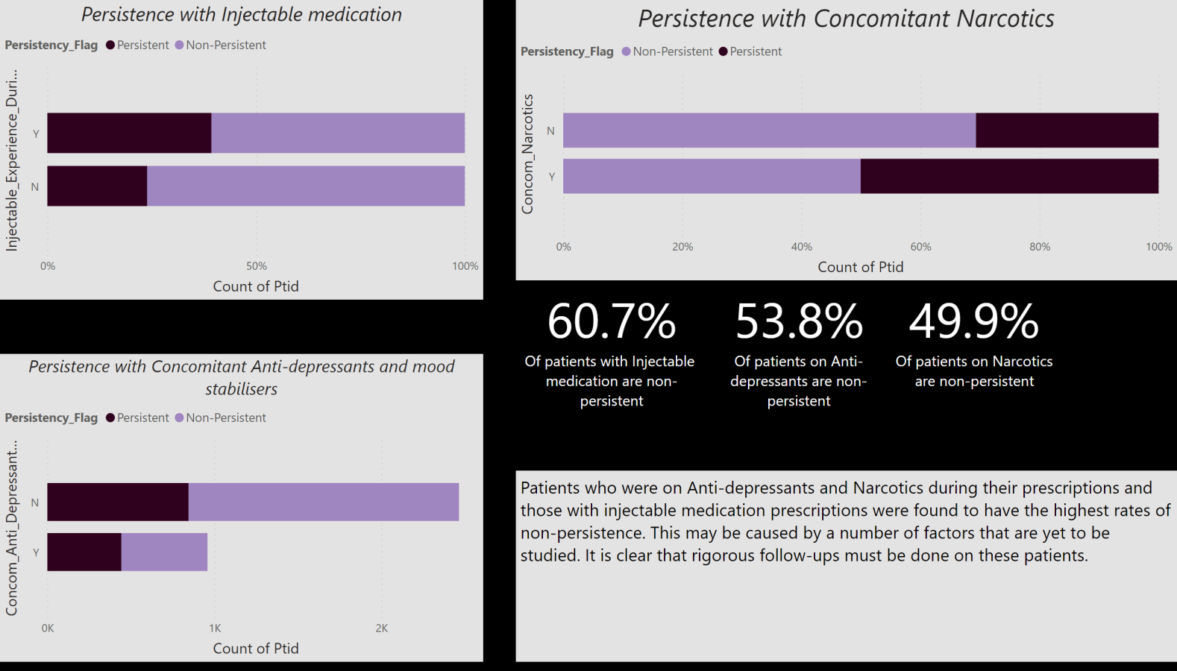

Slide 11
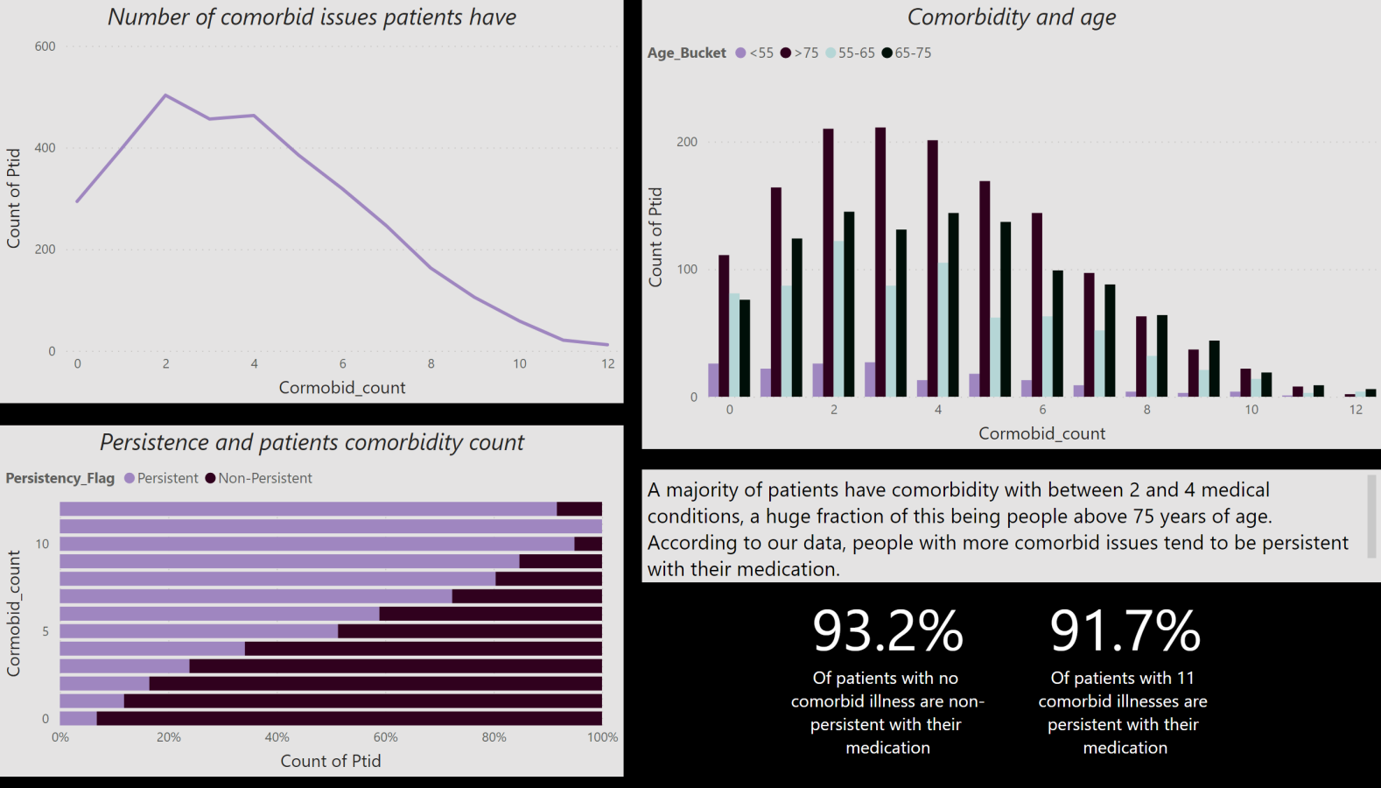

Slide 12
13
Model recommendation for technical user
Our aim is to create a classification model that will somewhat accurately predict whether a patient will be persistent or non-persistent with their treatment using the sample dataset.
We will start by splitting our model into train and test datasets since necessary cleaning and transformation have been done on our dataset.
We recommend using K-nearest neighbours and Support Vector Machines as our classifiers. Both classifiers will be trained on the training dataset after which we will proceed to make some predictions. We will perform a proper evaluation of both our models through different methods, some of them being: Logarithmic Loss and classification accuracy. The model that proves to be more efficient and accurate shall be implemented.

